Slide 1
Introduction to Pharmacology
This material has been complied by many authors & text material.
This is not the sole work of the presenter.

Slide 2
Introduction
Definitions
Pharmacology – study of the effect of chemicals on living tissue
Pharmacokinetics – study of absorption, distribution, metabolism and excretion of drugs
Pharaceutics- formation/preparation of drugs
Pharmacoeconomics – economic impact of drugs

Slide 3
Introduction
Definitions (cont)
Toxicology – harmful effects of drugs
Pharmacognosy – medicinal uses of natural occuring compounds
Pharmacy – preparation and dispensing
Pharmacogenetics – genetic influences by and on drugs
Pharmacodynamics – physiological and biochemical mechanism of action of drugs
Pharmacogenomics – identification of discreet genetic differences among individuals that play a critical role in drug response
Pharmacoepidemiology – drug effects on large groups of people

Slide 4
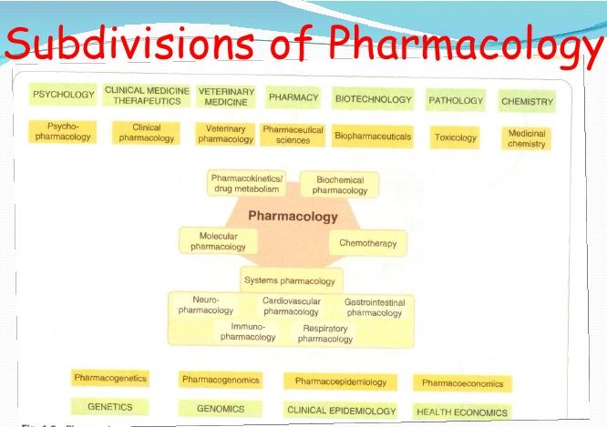

Slide 5
Pharmacology Terms
Agonists – bind to receptor to stimulate the function that the receptor serves
Antagonists – bind to the receptor to block the function the receptor serves
Competitive binding – reversible binding
Non-competitive binding – non reversible
ED50 – The effective dose in 50% of the population
TD50 – Toxic dose in 50% of the population
LD50 – Lethal dose in 50% of the population
LD50/ED50 – Therapeutic index
TD50/ED50 – (Therapeutic window) – the dose that can treat the disease or condition effectively while staying in safety range.

Slide 6
Drug Receptor
Receptor – a protein that binds to an endogenous chemical or drug
This coupling or binding results in a chain of events that lead to an effect
Common properties of receptors
Sensitivity
Drug response typically occurs in an environment of low concentration
Selectivity
The receptors are receptive to structurally similar chemicals etc.
Specificity
The cells on the receptors is the same and will determine response
Bonds
Go from a weakest to a strongest bond in order
Van der Walls Hydrophobic H+ Ionic Covalent

Slide 7
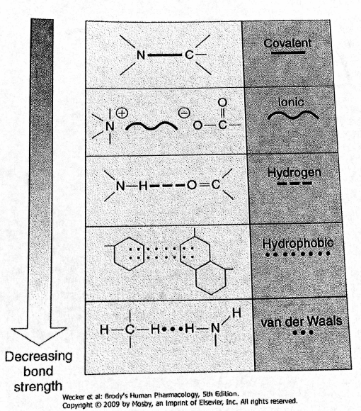
Chemical bonds and attractive forces that influence drug behaviour

Slide 8
Bonds
van der Waals forces
Van der Waals forces are driven by induced electrical interactions between two or more atoms or molecules that are very close to each other. Van der Waals interaction is the weakest of all intermolecular attractions between molecules.
Hydrophobic
Interaction between water and low water soluble molecules
i.e. the mixing of fat and water
Hydrogen
a weak electrostatic attraction between the hydrogen and an electronegative atom due to their difference in electronegativity
Ionic
When a positively charged ion forms a bond with a negatively charged ions and one atom transfers electrons to another. i.e. Sodium Chloride.
Covalent
A chemical bond formed by the sharing of one or more electrons, especially pairs of electrons, between atoms. i.e. CO (Carbon monoxide); CH4 (Methane).

Slide 9
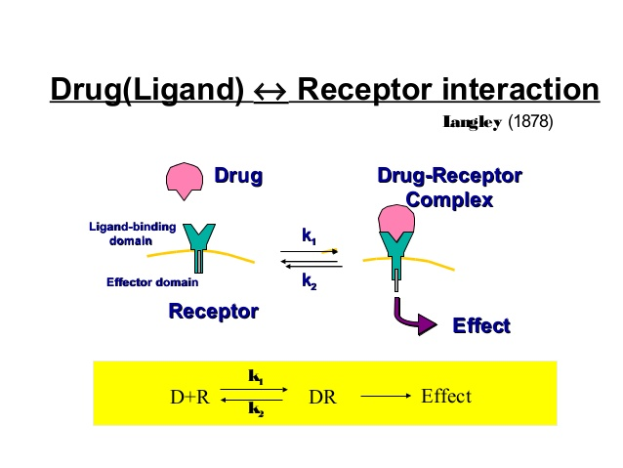
Receptor Theory

Slide 10
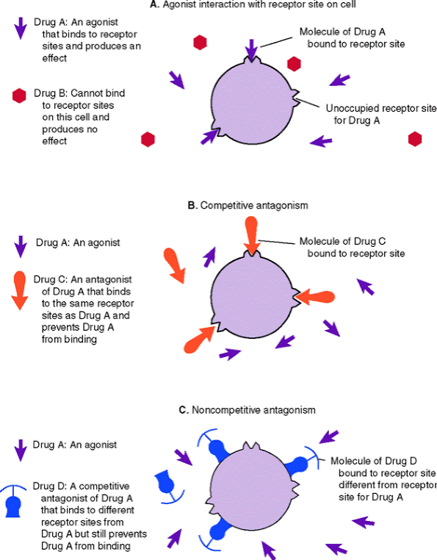
Receptor Theory

Slide 11
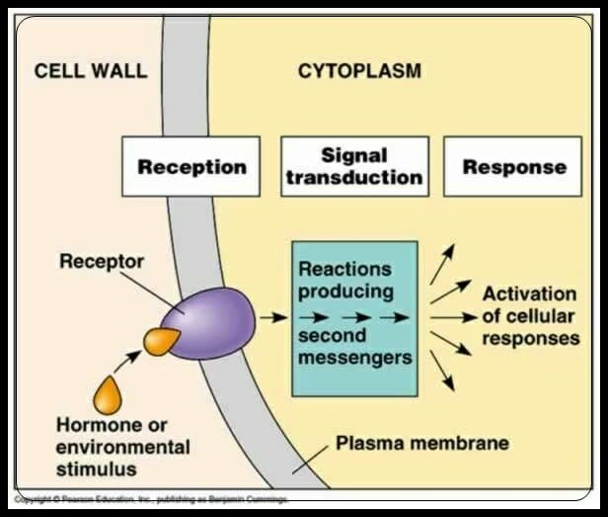
Signal Transduction
Signal transduction (also known as cell signaling) is the transmission of molecular signals from a cell's exterior to its interior. Signals received by cells must be transmitted effectively into the cell to ensure an appropriate response. This step is initiated by cell-surface receptors
Overall Signal transduction has three stages:
First (Reception) - the signal molecule binds to the receptor.
Second (Signal Transduction) - the chemical signal results in a series of enzyme activations.
Third (Response) - cellular responses.

Slide 12
Drug Response Equation
Derived from the law of mass action
A drug (D) combines with a receptor (R) to from a drug receptor complex (DRC) to elicit a Tissue Response (TR)
D + R ↔(DRC) ↔ TR
This is the basis for the DOSE-RESPONSE CURVE
a curve plotting the relationship between the dose of a drug administered and its pharmacological effect

Slide 13
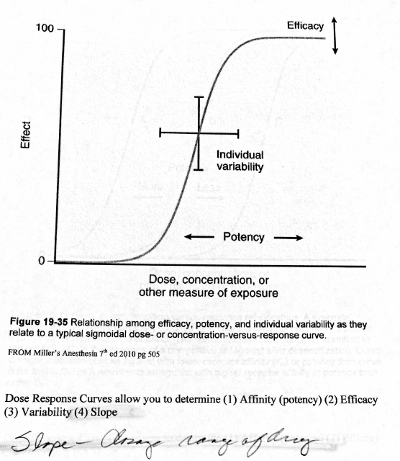
Dose Response Curves/Slope

Slide 14
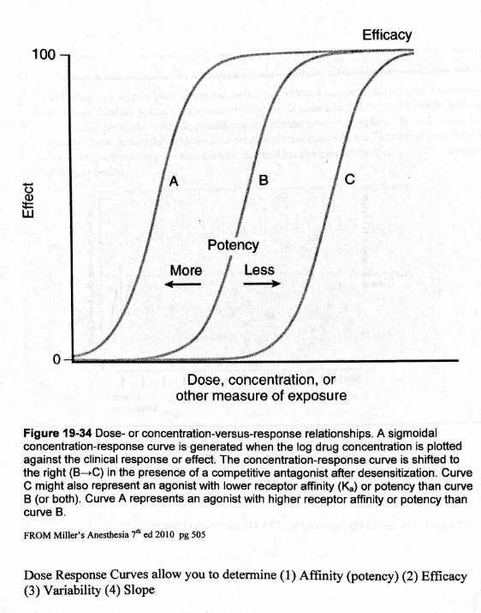
Dose Response Curves

Slide 15
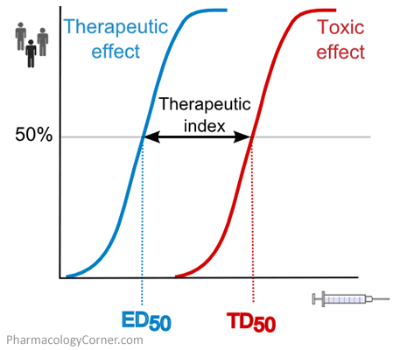
Dose response curves
Increasing Potency

Slide 16
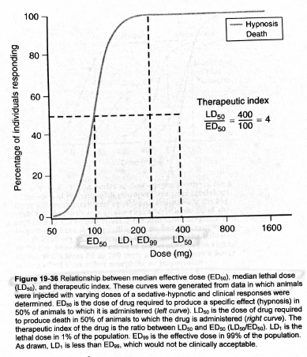
Relationships between ED-LD

Slide 17
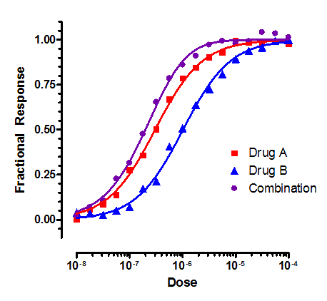
Effect of drug combinations

Slide 18
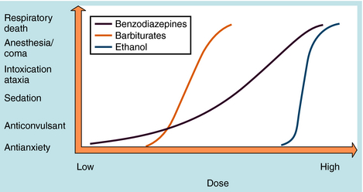
Dose Response

Slide 19
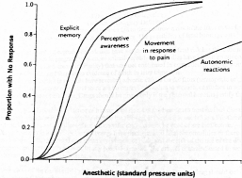
Dose Response for Anesthesia agents

Slide 20
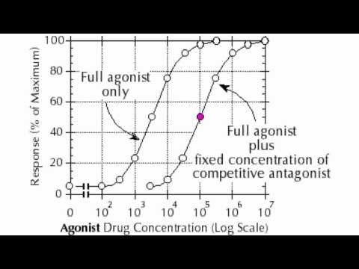
Dose Response
https://www.youtube.com/watch?v=cnnaKiXCHzE

Slide 21
Graded Dose Response
Graded dose response is a dose that plotted in a linear fashion and changes as the dose is increased to achieve a maximal response. The dose has a hyperbolic shape with the greatest change in response occurring to the left on a small portion of the x -axis.

Slide 22
Graded Dose Response
When plotted on a logarithmic scale, the graded dose response curve takes an S-shape; at the lowest dose, the measured response (i.e. vascular response to norepinephrine) is small or nonexistent. At the highest doses the response is maximal and approaches a plateau. Typically at some point between 20-80% of the maximal response the curve approaches a straight line because the changes in dose and response reflect the proportional relationship.

Slide 23
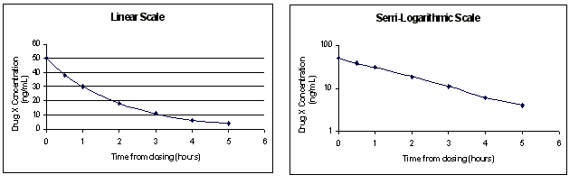
Semi logarithmic scale
Concentration time profile is the association between drug concentrations and collection time points to measure this concentration. Concentration time profiles can be expressed using a linear or semi logarithmic scale.
The purpose of using the semi-logarithmic scale for graphing is to transform a non-linear data, which is the case of concentration time data, into a linear one. Since it is simpler to calculate the parameter such as slope from a straight line than from a curve, the concentration-time profile is often plotted on semi-logarithmic scales. The area of the slope is needed to determine the dose of the drug correlated to a the drug concentration at a given time point. This will allow you to also determine when the drug needs re-dosing etc.

Slide 24
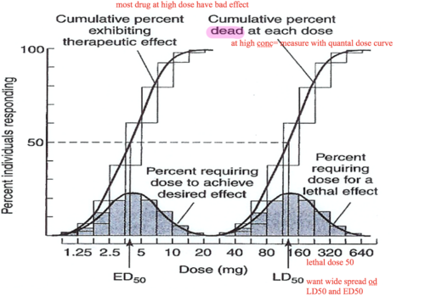
Quantal Dose Response
A quantal dose-response curve provides information on the frequency a drug dose produces a desire therapeutic response in a patient population (also describes the variation in responses within a population)
For example: A small number of patients will go to sleep following an induction dose of 0.5 mg/kg of propofol, more will be induced at 1 mg/kg but virtually all will be induced as 2-3 mg/kg

Slide 25
Quantal Dose Response Curves
Theoretical normal distribution of a quantal (desired) responses to increasing the
drug dose and used to determine the typical and atypical doses (SD) as well
as where the mean and median and mode of the doses are found

Slide 26
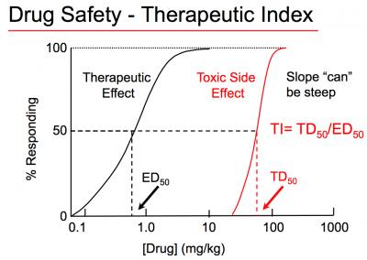
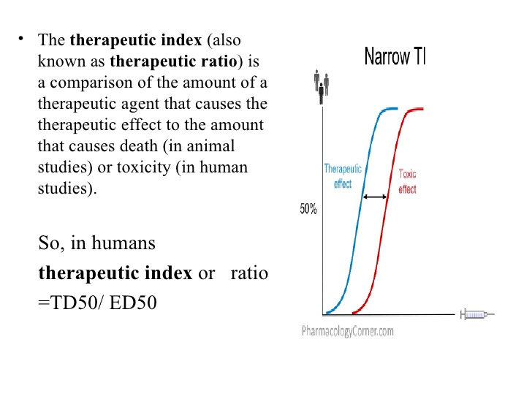
Quantal Dose
Reflects population variance
Allows for descriptors such as Toxic Dose (TD), Effective Dose 99% (ED99) and Lethal Dose 1% (LD1)
Identifies the therapeutic safety margin of the drug using the equation
Therapeutic Index
LD50 /ED50 describes the therapeutic safety margin of the drug

Slide 27
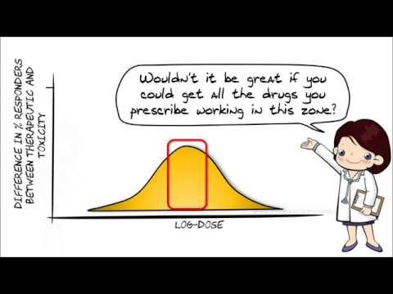
Quantal Dose
https://youtu.be/40hbv-uJ1us

Slide 28
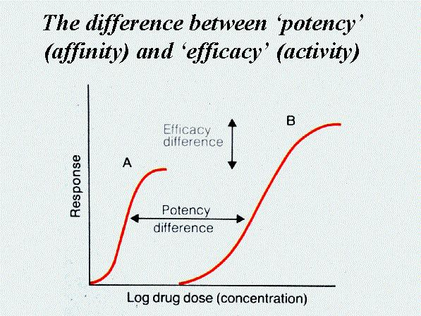
Drug Affinity & Efficacy
Affinity & Efficacy describe the degree of drug receptor interaction for a given drug and receptor protein population (i.e. the way propofol works on the GABA receptor)
A drug receptor interaction will elicit a quantum of excitation and the summation of this quanta will produce a tissue response; this will then show the relationship from the dose response to equate the potency, efficacy, variability and slope of the drug.

Slide 29
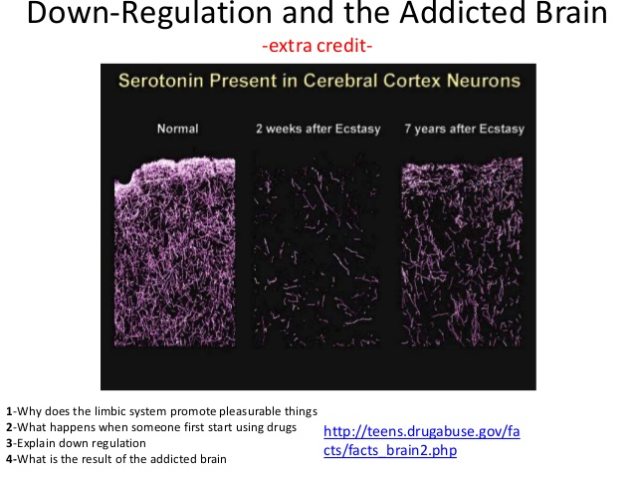
Receptor Regulation & Adaption
Down Regulation - Development of a refractory or tolerant state consequent on repeated administration of a pharmacologically or physiologically active substance; often accompanied by an initial decrease in affinity of receptors for the agent and a subsequent diminution in the number of receptors.

Slide 30
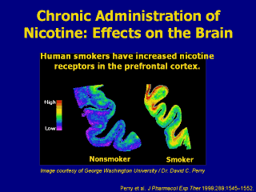
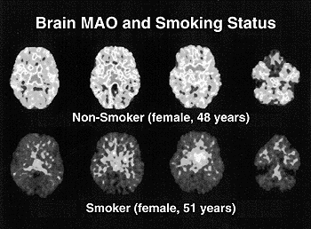
Receptor Regulation & Adaption
Up-Regulation – the number and sensitivity of the receptors increase as a response to chronic blockade
Chronic administration of nicotine results in an increased number of nicotine receptors in specific regions of the brain. This up-regulation of nicotine receptors leads to the development of tolerance. Tolerance is a phenomenon by which repeated doses of a drug produce less of an effect than did the initial exposure.

Slide 31
FDA Pregnancy Risk Classification

Slide 32
Common Drugs with Classification

Slide 33
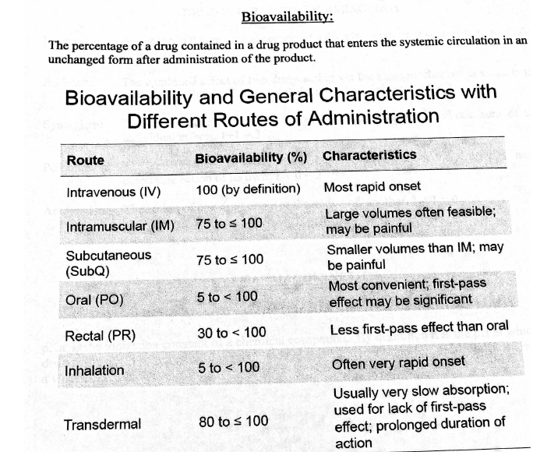
Bioavailability

Slide 34
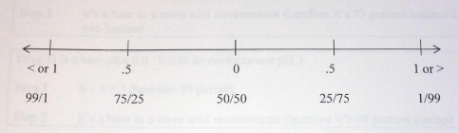
Pharmacokinetics
Definitions
Interaction, Addition, Synergism, Potentiation, Antagonism
Drug Ionization
Ionization constant of a chemical compound. It is the pH at which drug will exist in solution as 50% ionized and 50% unionized. All drugs are either weak bases or acids.

Slide 35
Drug Ionization
How to determine the extent of ionization
Step 1
Doesn’t matter if the number is positive or negative
If the pH - pKa = 0 then the ratio is 50%
i.e. pH 7.4 – pKa 7.4 = 0
If the pH - pKa = approximately 0.5 then the ratio is 75% ionized/25% unionized
i.e. pH 6.8 – pKa 6.35 = 0.45
If the pH – pKa = approximately 1 then the ratio is 99% ionized/1% unionized
i.e pH 5.8 - pKa 6.7 = 1.1

Slide 36
Hints
Step 2 hints
Acids in acid pH = non-ionized
Acids in base pH = ionized
Bases in base pH = non-ionized
Bases in acid pH = ionized
pKa dose not measure acid base status but the extent of ionization

Slide 37
pKa
Sample problems
Drug B is an acid with a pKa of 6.9 and placed in an acid environment of 5.3
Drug C is a base with a pKa of 7.8 and placed into an acid environment of 5.5
Drug C is a base with a pKa of 7.8 and placed into a basic environment of 7.8

Slide 38
Hints
Bases
If pH > pKa then non-ionized predominates
If pH = pKa then both are equal
If pH < pKa then ionized predominates
Acids
If pH < pKa then non-ionized predominates
If pH = pKa then both are equal
If pH > pKa then ionized predominates

Slide 39
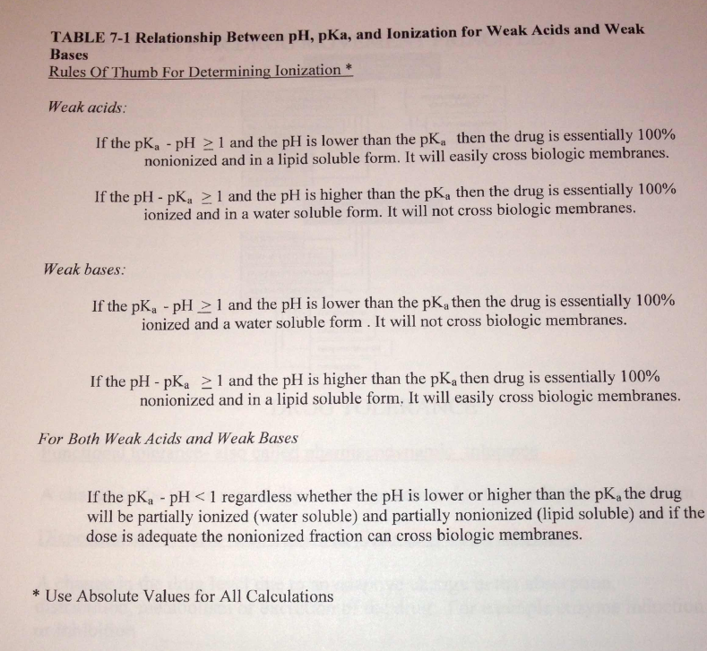

Slide 40
Drug Movement Principles
Pharmacodynamic tolerance (functional tolerance) – A change in tissue sensitivity to a drugs action due to adaptive mechanism
Example: Tolerance to opioids/alcohol etc.
Pharmacokinetic tolerance (dispositional tolerance) – A change in the drug level due to an adaptive change in the absorption, distribution, metabolism or excretion of a drug
Example: The college student that metabolizes induction agent following a heavy weekend of partying; patients on cimetidine etc.

Slide 41
Drug movement concepts
Affinity or potency: as it relates to agonists the term potency is used to differentiate between different agonists that activate the same receptor. The most potent drug requires the lowest dose
Example: You get the same effect from 5 mg of Morphine sulfate that you get from 50 mcg of Fentanyl
The fentanyl is 100 times more potent than morphine
Example: You get the same effect from 5 mg of Morphine sulfate as you get from 0.8 mg of hydromorphone so by giving 1 mg of hydromorphone you are giving a total dose of approximately 6.5 mg of morphine sulfate

Slide 42
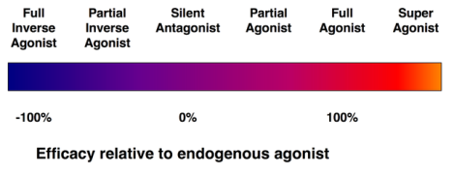
Intrinsic Activity (efficacy)
The efficacy of a drug is its ability to produce the desire response expected by stimulation of a given receptor population. It refers to the maximum possible effect that can be achieved by a drug.
These all work on different receptors and based on the affinity of the agonist has towards the receptor

Slide 43
Agonists
Superagonists - a type of agonist that is capable of producing a maximal response greater than the endogenous agonist for the target receptor, and thus has an efficacy of more than 100%
Fentanyl can be considered a super agonist in that it is 100 times more potent at the opioid mu receptors than morphine.
Full Agonist - activate a receptor, producing full efficacy at that receptor.
One example of a drug that acts as a full agonist is isoproterenol, which mimics the action of epinephrine at β adrenoreceptors.

Slide 44
Agonists
Partial Agonists - drugs that bind to and activate a given receptor, but have only partial efficacy at the receptor relative to a full agonist. They may also be considered ligands which display both agonistic and antagonistic effects — when both a full agonist and partial agonist are present, the partial agonist actually acts as a competitive antagonist, competing with the full agonist for receptor occupancy and producing a net decrease in the receptor activation observed with the full agonist alone.
Clinically, partial agonists can be used to activate receptors to give a desired submaximal response when inadequate amounts of the endogenous ligand are present, or they can reduce the overstimulation of receptors when excess amounts of the endogenous ligand are present.
Examples are Butorphanol and Nalbuphine HCL

Slide 45
Agonists
Silent Antagonist - are competitive receptor antagonists that have zero intrinsic activity for activating a receptor. They are true antagonists.
Examples include alpha, beta and calcium channel blockers
Inverse Antagonist - have effects similar to those of an antagonist, but causes a distinct set of downstream biological responses. Many drugs originally classified as a silent antagonist (i.e. diphenydramine originally classified as an H-1 receptor antagonist) are now classified as an inverse antagonist because of new discoveries of active receptors that are activated by those originally thought as antagonists.

Slide 46
Spare receptor concept
Receptors may be considered spare when the maximal response is elicited by an agonist at a concentration that does not produce full occupancy of the available receptors, or when a maximum drug response is achieved prior to saturation of the receptors.
A good example of this is the Myocardium. You can achieve maximal ionotropic response to a catecholamine when only less than 10% of the receptors are occupied.
It only takes a little epinephrine to elicit a myocardial response
A good example is the “test dose” that is given to determine if a CLE (continuous lumbar epidural) catheter is intravascular
We typically give a total of 3 ml of 1.5 % lidocaine with 1:200000 epinephrine

Slide 47
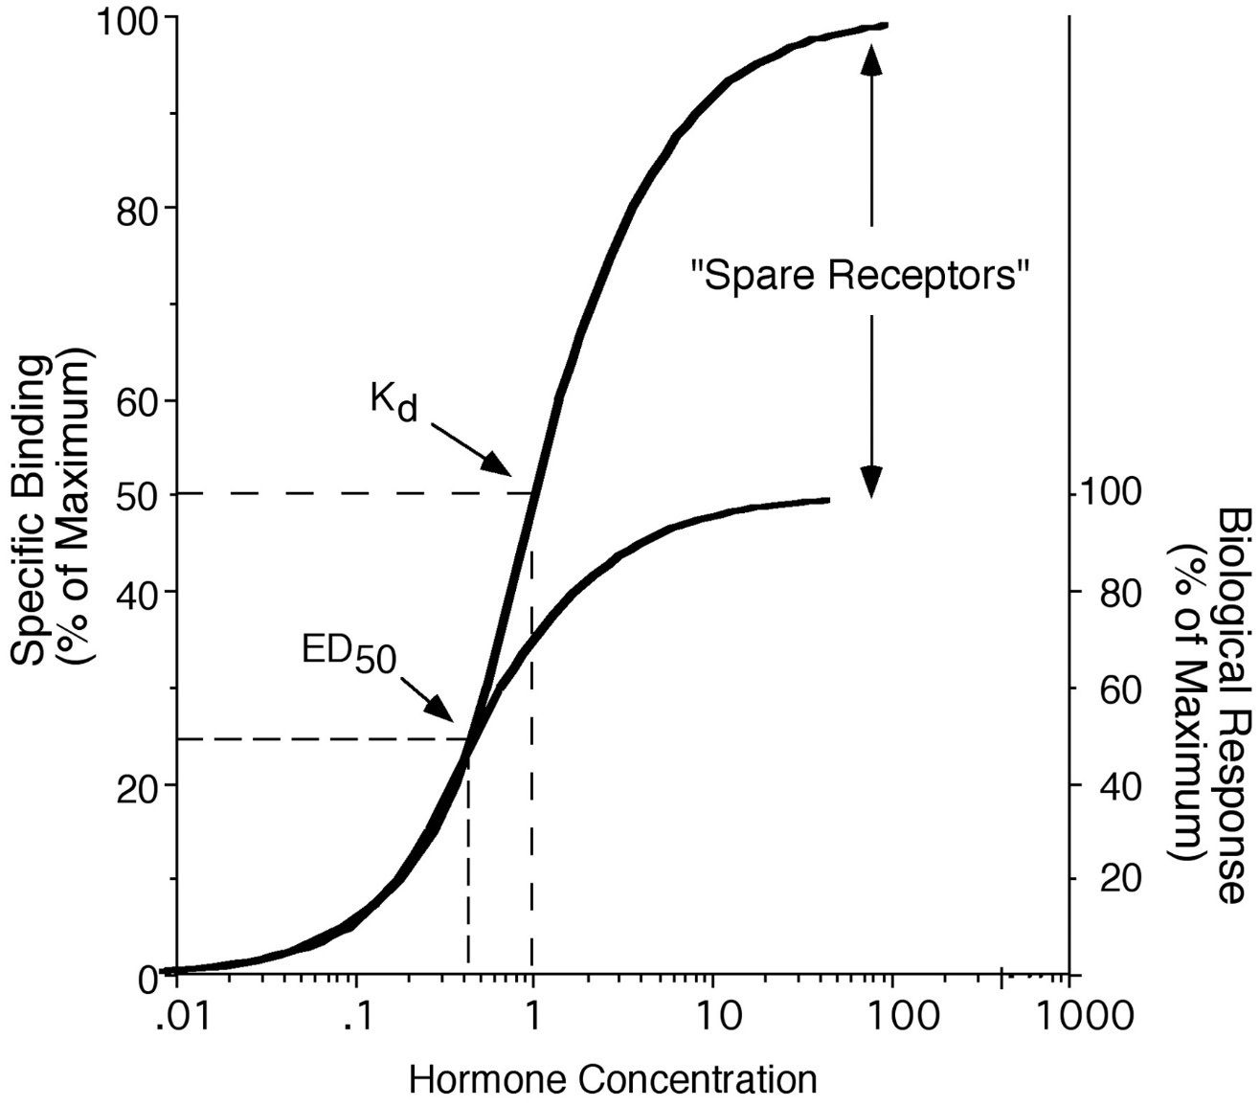
Spare Receptor

Slide 48
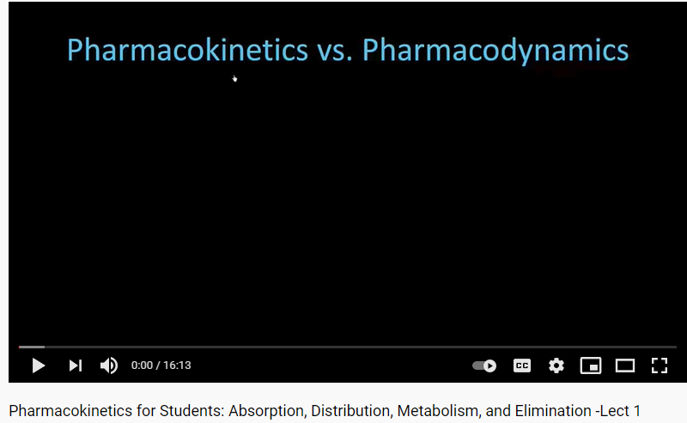
Pharmacokinetic/Dynamics
https://www.youtube.com/watch?v=CMRZqdrkCZw

Slide 49
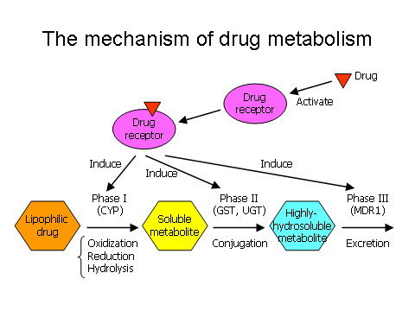

Slide 50
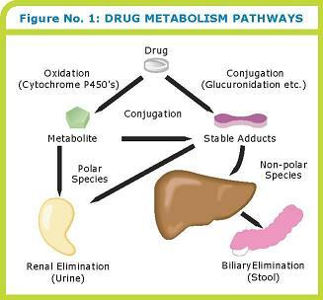

Slide 51
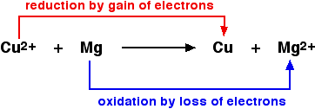
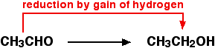
Metabolism
Most reactions are categorized into groups:
Oxidation
Loss of electrons (H+) & gain of O2
Combination with oxygen.
Reduction
Gain of electrons (H+) & loss of O2

Slide 52
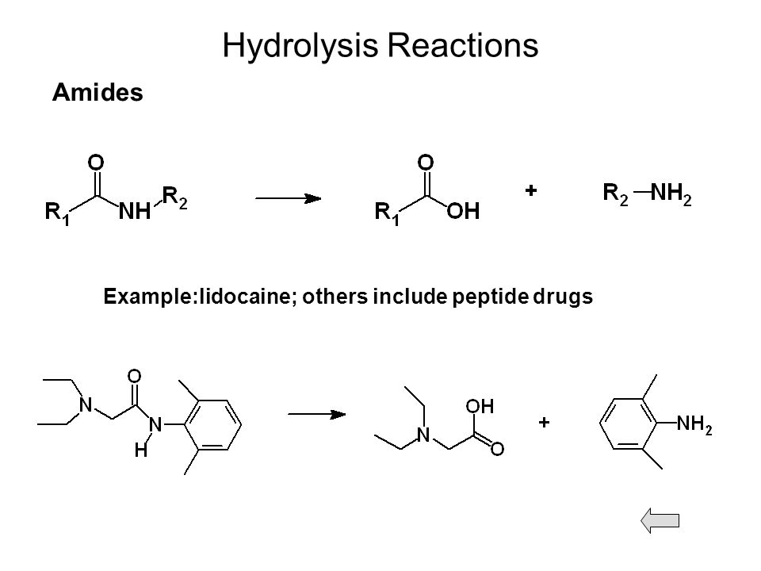
Hydrolysis
Hydrolysis -a chemical process of decomposition involving the splitting of a bond and the addition of the hydrogen cation and the hydroxide anion of water

Slide 53
Phase 2 Metabolism
Involve conjugation from a reactive group usually inserted during phase 1 that results in either a more inactive or active substance
Conjugation
The combination, especially in the liver, of certain toxic substances formed in the intestine, drugs, or steroid hormones with glucuronic or sulfuric acid; a means by which the biologic activity of certain chemical substances is terminated and the substances made ready for excretion.
The joining together of two compounds that promote excretion
First pass effect-a phenomenon of drug metabolism whereby the concentration of a drug is greatly reduced before it reaches the systemic circulation
Notable drugs that experience a significant first-pass effect are imipramine, morphine, propranolol, buprenorphine, diazepam, midazolam, pethidine, cimetidine, lidocaine, and nitroglycerin

Slide 54
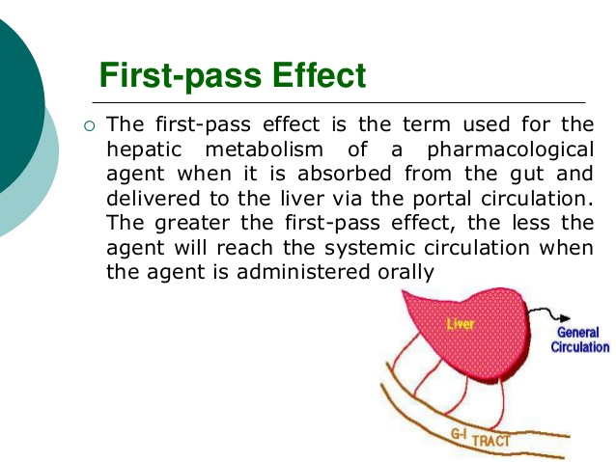

Slide 55
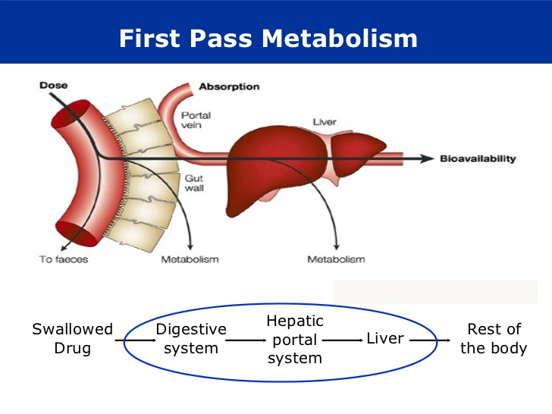
First Pass Metabolism

Slide 56
Cytochrome p450
C-p450 produce enzymes that are involved in the synthesis and metabolism of molecules & chemicals w/in the cells
C-p450 play a role in synthesis in steroid hormones, chloresterol, fatty acids and bile acids
C-p450 is primarily known for its role in metabolism of drugs
There are 60 different CYP genes in humans
Primarily found in the liver(75%)/Intestines (19%)
If a C-p450 enzyme metabolizes the drug slowly the drug stays in the system longer and vice versa
Involved with 70-80% of all enzymes involved in drug metabolism

Slide 57
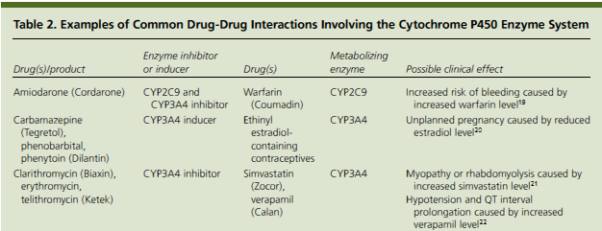
Cytochrome p450
Cytochrome p450 Inducers –
Inducers- increase Cyto p450 enzyme activity by increasing synthesis of enzymes resulting in an increase in the drug metabolism
Inhibitors- block the enzymatic activity of one or more enzymes in the Cyto p450

Slide 58
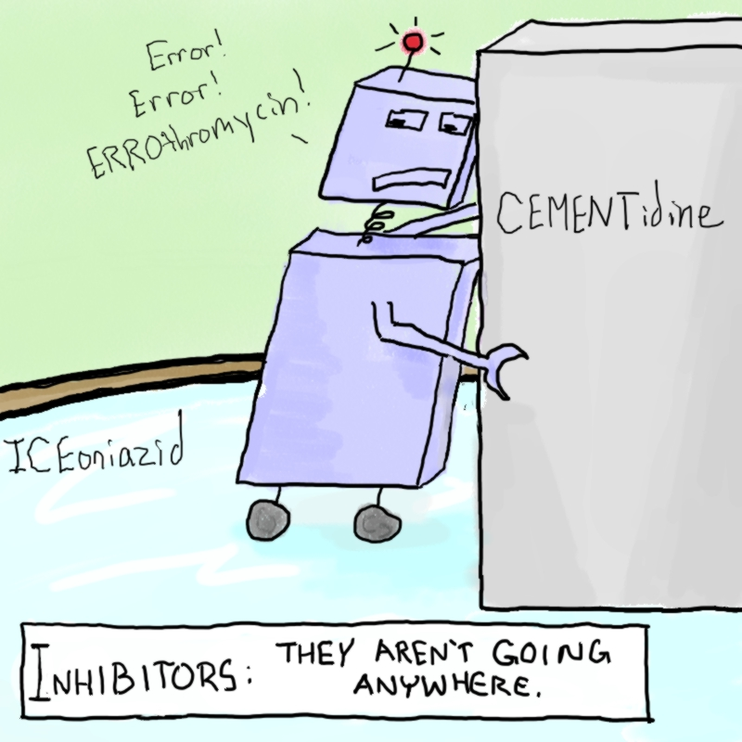

Slide 59
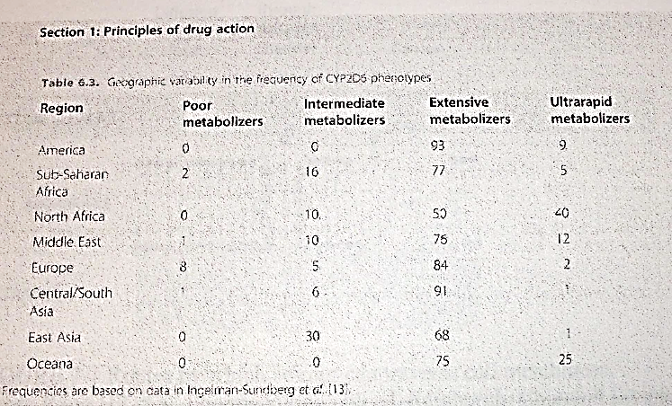

Slide 60
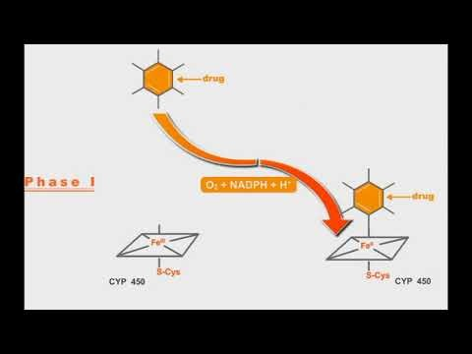
Phase 1&2 Metabolism
https://youtu.be/MRjOl1-SwTM

Slide 61
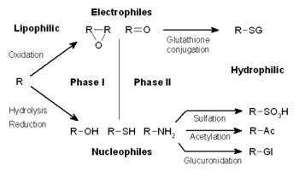
Phase 1 & Phase 2 metabolism

Slide 62
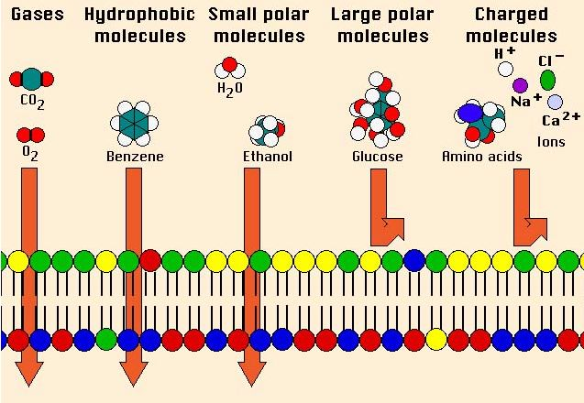
Pharmacokinetics (again!)
Pharmacokinetics – study of absorption, distribution, metabolism and excretion of drugs
Most drugs are weak acids or bases (pKa etc).
Absorption/action often based on lipid solubility

Slide 63
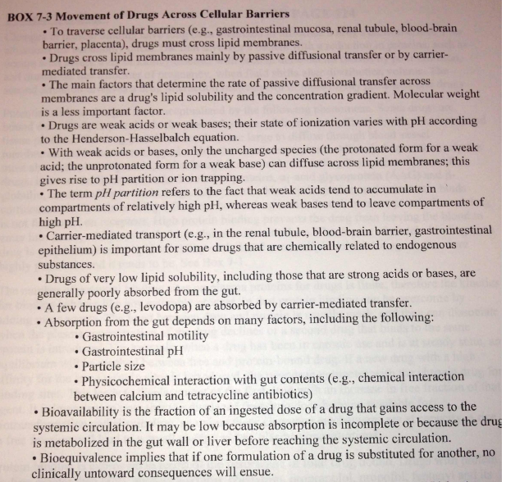
Pharmacokinetics (again!)

Slide 64
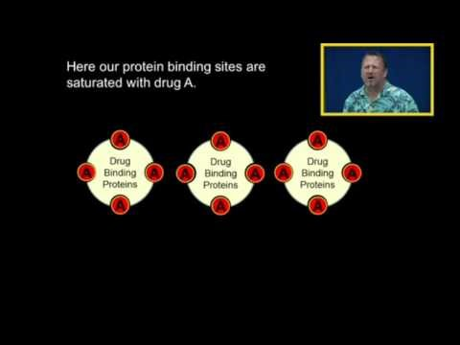
Protein Binding
https://youtu.be/sfR8lGQSKic

Slide 65
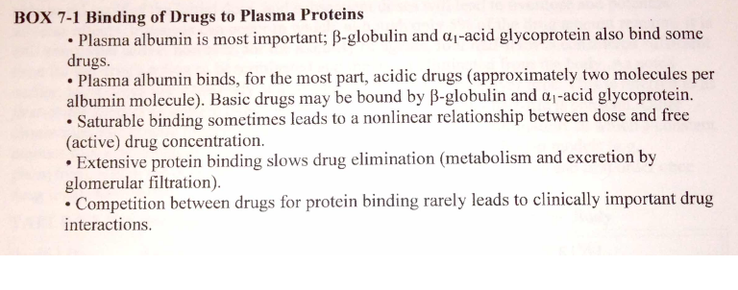
Protein Binding of Drugs

Slide 66
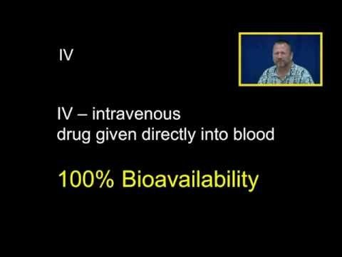
Bioavailability
https://youtu.be/74grCfmmKL8

Slide 67
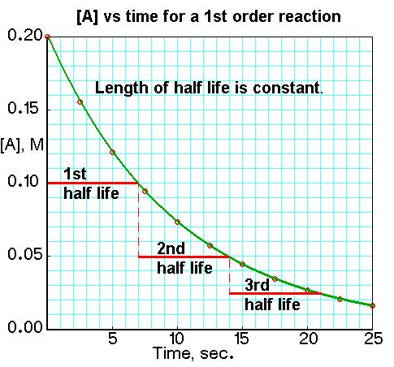
First Order Kinetics

Slide 68
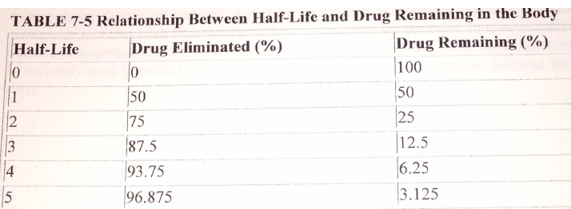
Elimination Half - Lives

Slide 69
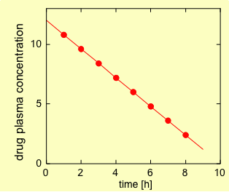
Zero Order Kinetics

Slide 70
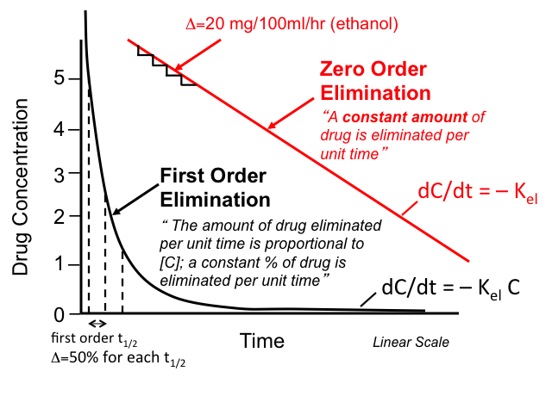
Zero & First Order Kinetics

Slide 71
Context Sensitive Half-time
The context-sensitive half-time is the time required for blood or plasma concentrations of a drug to decrease by 50% after discontinuation of drug administration.
Cannot be predicted by the elimination half-life (a measure of the time needed for actual drug metabolism or elimination) because it also depends on drug distribution
It is a useful concept because it helps explain the duration of action of a drug given by infusion after stopping the infusion

Slide 72
Context Sensitive Half-time
It reflects several pharmacokinetic principles:
First, as any drug is infused into the body more of the drug will deposit in the body’s tissues (i.e., accumulate) the longer the duration of infusion (or “context” as it is known) until the body’s tissues are completely saturated. Once the drug infusion is stopped this stored drug will then redistribute back into the blood and maintain its effects.
Second, every drug accumulates to differing extents, which is largely influenced by the physicochemical properties of the drug
Third, drugs are removed from the blood through two major mechanisms:
Distribution: where the drug moves from the blood into the tissues, e.g., fat.
Excretion: where the drug is either metabolized (e.g., by the liver) or excreted from the body unchanged (e.g., in urine). Whether or not the metabolites are active is also important.

Slide 73
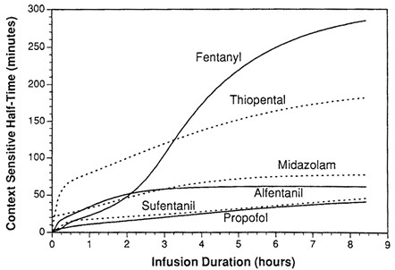
Context Sensitive/Decrement Half-time
The time taken for blood plasma concentration of a drug to decline by one half after an infusion designed to maintain a steady state (i.e. a constant plasma concentration) has been stopped. The "context" is the duration of infusion. This defines the context sensitive half-time
The time for a 50% decrease in central compartment drug concentration or the time from the end of infusion until a 50% recovery is the Constant Decrement time

Slide 74
Key Points
Review key points at the end of each section in the workbook
Read the sections in the Textbook
Keep studying, keep studying, keep studying!!!

